Slide 1
The Bayes Net Toolbox for Matlab and applications to computer vision
Kevin Murphy
MIT AI lab

Slide 2
Outline of talk
BNT

Slide 3
Outline of talk
BNT
Using graphical models for visual object detection

Slide 4
Outline of talk
BNT
Using graphical models (but not BNT!) for visual object detection
Lessons learned: my new software philosophy

Slide 5
Outline of talk: BNT
What is BNT?
How does BNT compare to other GM packages?
How does one use BNT?

Slide 6
What is BNT?
BNT is an open-source collection of matlab functions for (directed) graphical models:
  exact and approximate inference
  parameter and structure learning
Over 100,000 hits and about 30,000 downloads since May 2000
Ranked #1 by Google for “Bayes Net software”
About 43,000 lines of code (of which 8,000 are comments)
Typical users: students, teachers, biologists
www.ai.mit.edu/~murphyk/Software/BNT/bnt.html

Slide 7
BNT’s class structure
Models – bnet, mnet, DBN, factor graph, influence (decision) diagram (LIMIDs)
CPDs – Cond. linear Gaussian, tabular, softmax, etc
Potentials – discrete, Gaussian, CG
Inference engines
  Exact - junction tree, variable elimination, brute-force enumeration
  Approximate - loopy belief propagation, Gibbs sampling, particle filtering (sequential Monte Carlo)
Learning engines
  Parameters – EM
  Structure - MCMC over graphs, K2, hill climbing
Green things are structs, not objects

Slide 8
Kinds of models that BNT supports
Classification/ regression: linear regression, logistic regression, cluster weighted regression, hierarchical mixtures of experts, naïve Bayes
Dimensionality reduction: probabilistic PCA, factor analysis, probabilistic ICA
Density estimation: mixtures of Gaussians
State-space models: LDS, switching LDS, tree-structured AR models
HMM variants: input-output HMM, factorial HMM, coupled HMM, DBNs
Probabilistic expert systems: QMR, Alarm, etc.
Limited-memory influence diagrams (LIMID)
Undirected graphical models (MRFs)

Slide 9
Brief history of BNT
Summer 1997: started C++ prototype while intern at DEC/Compaq/HP CRL
Summer 1998: First public release (while PhD student at UC Berkeley)
Summer 2001: Intel decided to adopt BNT as prototype for PNL

Slide 10
Why Matlab?
Pros (similar to R)
  Excellent interactive development environment
  Excellent numerical algorithms (e.g., SVD)
  Excellent data visualization
  Many other toolboxes, e.g., netlab, image processing
  Code is high-level and easy to read (e.g., Kalman filter in 5 lines of code)
  Matlab is the lingua franca of engineers and NIPS
Cons:
  Slow
  Commercial license is expensive
  Poor support for complex data structures
Other languages I would consider in hindsight:
  R, Lush, Ocaml, Numpy, Lisp, Java

Slide 11
Why yet another BN toolbox?
In 1997, there were very few BN programs, and all failed to satisfy the following desiderata:
  Must support vector-valued data (not just discrete/scalar)
  Must support learning (parameters and structure)
  Must support time series (not just iid data)
  Must support exact and approximate inference
  Must separate API from UI
  Must support MRFs as well as BNs
  Must be possible to add new models and algorithms
  Preferably free
  Preferably open-source
  Preferably easy to read/ modify
  Preferably fast
BNT meets all these criteria except for the last

Slide 12
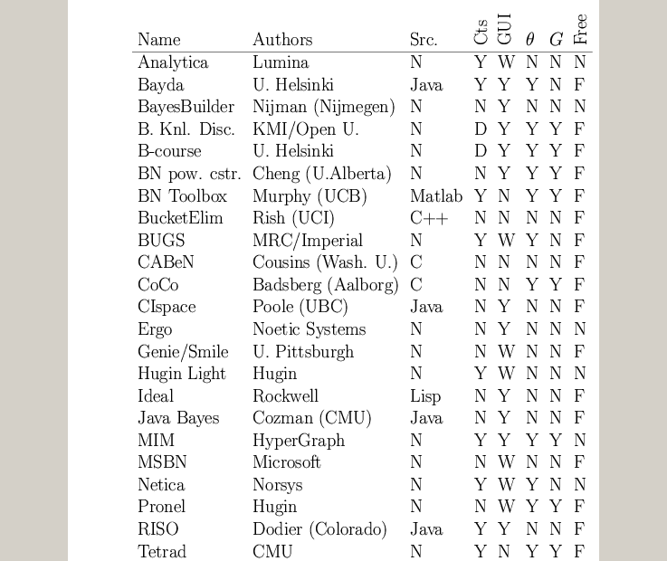
A comparison of GM software
www.ai.mit.edu/~murphyk/Software/Bayes/bnsoft.html

Slide 13
Summary of existing GM software
~8 commercial products (Analytica, BayesiaLab, Bayesware, Business Navigator, Ergo, Hugin, MIM, Netica); most have free “student” versions
~30 academic programs, of which ~20 have source code (mostly Java, some C++/ Lisp)
See appendix of book by Korb & Nicholson (2003)

Slide 14
Some alternatives to BNT
HUGIN: commercial
  Junction tree inference only
PNL: Probabilistic Networks Library (Intel)
  Open-source C++, based on BNT, work in progress (due 12/03)
GMTk: Graphical Models toolkit (Bilmes, Zweig/ UW)
  Open source C++, designed for ASR (cf HTK), binary avail now
AutoBayes: (Fischer, Buntine/NASA Ames)
  Prolog generates model-specific matlab/C, not avail. to public
BUGS: (Spiegelhalter et al., MRC UK)
  Gibbs sampling for Bayesian DAGs, binary avail. since ’96
VIBES: (Winn / Bishop, U. Cambridge)
  Variational inference for Bayesian DAGs, work in progress

Slide 15
What’s wrong with the alternatives
All fail to satisfy one or more of my desiderata,
mostly because they only support one class of models and/or inference algorithms
  Must support vector-valued data (not just discrete/scalar)
  Must support learning (parameters and structure)
  Must support time series (not just iid data)
  Must support exact and approximate inference
  Must separate API from UI
  Must support MRFs as well as BNs
  Must be possible to add new models and algorithms
  Preferably free
  Preferably open-source
  Preferably easy to read/ modify
  Preferably fast

Slide 16
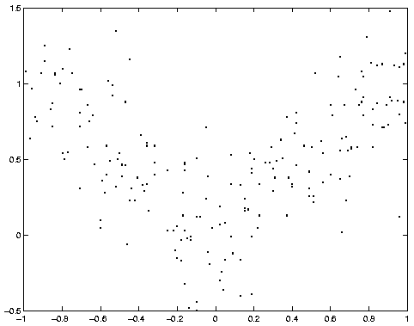
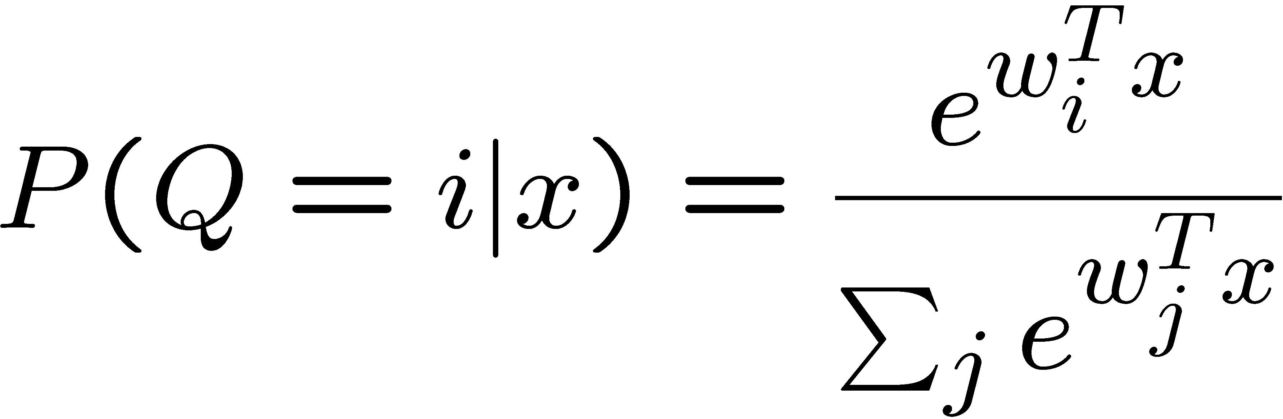
How to use BNT e.g., mixture of experts
X
Q
Y
softmax/logistic function

Slide 17
1. Making the graph
X = 1; Q = 2; Y = 3;
dag = zeros(3,3);
dag(X, [Q Y]) = 1;
dag(Q, Y) = 1;
X
Q
Graphs are (sparse) adjacency matrices
GUI would be useful for creating complex graphs
Repetitive graph structure (e.g., chains, grids) is best
created using a script (as above)
Y

Slide 18
2. Making the model
X
node_sizes = [1 2 1];
dnodes = [2];
bnet = mk_bnet(dag, node_sizes, …
‘discrete’, dnodes);
Q
X is always observed input, hence only one effective value
Q is a hidden binary node
Y is a hidden scalar node
bnet is a struct, but should be an object
mk_bnet has many optional arguments, passed as string/value pairs
Y

Slide 19
3. Specifying the parameters
X
bnet.CPD{X} = root_CPD(bnet, X);
bnet.CPD{Q} = softmax_CPD(bnet, Q);
bnet.CPD{Y} = gaussian_CPD(bnet, Y);
Q
CPDs are objects which support various methods such as
  Convert_from_CPD_to_potential
  Maximize_params_given_expected_suff_stats
Each CPD is created with random parameters
Each CPD constructor has many optional arguments
Y

Slide 20
4. Training the model
X
load data –ascii;
ncases = size(data, 1);
cases = cell(3, ncases);
observed = [X Y];
cases(observed, :) = num2cell(data’);
Q
Y
Training data is stored in cell arrays (slow!), to allow for
variable-sized nodes and missing values
cases{i,t} = value of node i in case t
engine = jtree_inf_engine(bnet, observed);
Any inference engine could be used for this trivial model
bnet2 = learn_params_em(engine, cases);
We use EM since the Q nodes are hidden during training
learn_params_em is a function, but should be an object

Slide 21
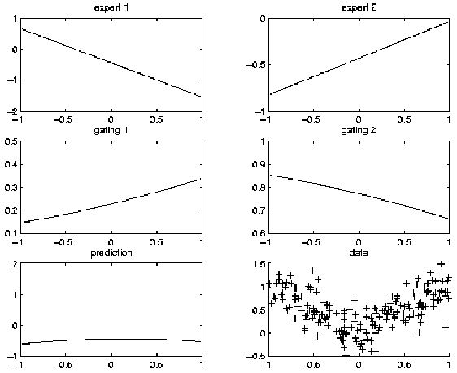
Before training

Slide 22
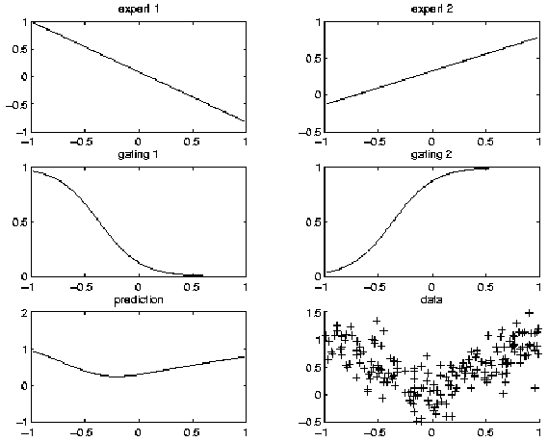
After training

Slide 23
5. Inference/ prediction
engine = jtree_inf_engine(bnet2);
evidence = cell(1,3);
evidence{X} = 0.68; % Q and Y are hidden
engine = enter_evidence(engine, evidence);
m = marginal_nodes(engine, Y);
m.mu % E[Y|X]
m.Sigma % Cov[Y|X]
X
Q
Y

Slide 24
A peek under the hood: junction tree inference
Create Jtree using graph theory routines
Absorb evidence into CPDs, then convert to potentials (normally vice versa)
Calibrate the jtree
Computational bottleneck: manipulating multi-dimensional arrays (for multiplying/ marginalizing discrete potentials) e.g.,
Non-local memory access patterns
φ3(A,B,C,D) = φ1(A,C) * φ2(B,C,D)
φ4(A,C) = ∑_{b,d} φ3(A,b,C,d)

Slide 25
Summary of BNT
CPDs are like “lego bricks”
Provides many inference algorithms, with different speed/ accuracy/ generality tradeoffs (to be chosen by user)
Provides several learning algorithms (parameters and structure)
Source code is easy to read and extend

Slide 26
What’s wrong with BNT?
It is slow
It has little support for undirected models
It does not support online inference/learning
It does not support Bayesian estimation
It has no GUI
It has no file parser
It relies on Matlab, which is expensive
It is too difficult to integrate with real-world applications e.g., visual object detection

Slide 27
Outline of talk: object detection
What is object detection?
Standard approach to object detection
Some problems with the standard approach
Our proposed solution: combine local,
bottom-up information with global, top-down information using a graphical model

Slide 28
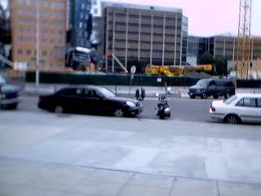
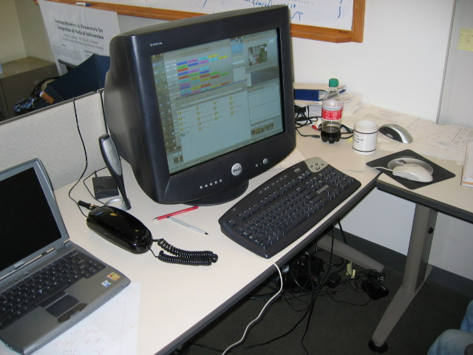
What is object detection?
Goal: recognize 10s of objects in real-time from wearable camera

Slide 29
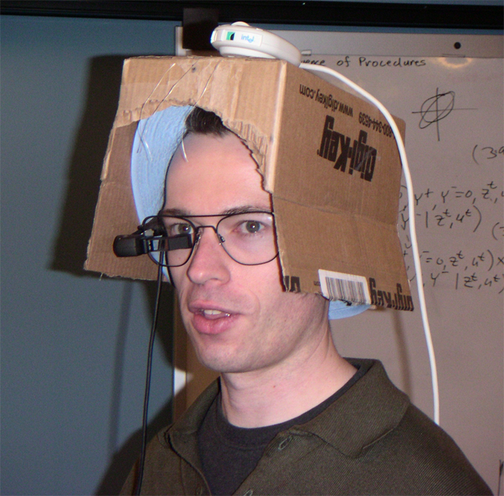
Our mobile rig, version 1
Kevin Murphy

Slide 30
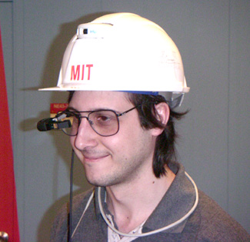
Our mobile rig, version 2
Antonio Torralba

Slide 31

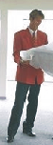


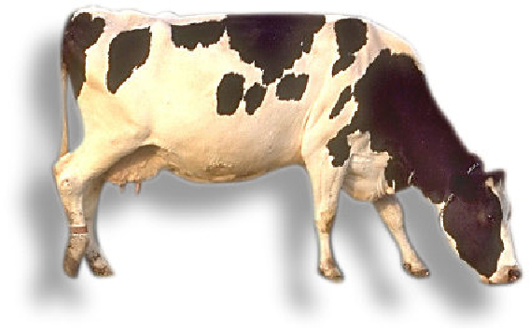
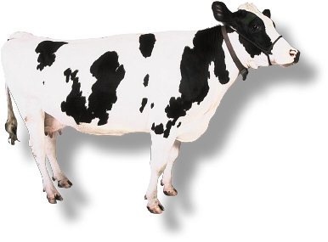


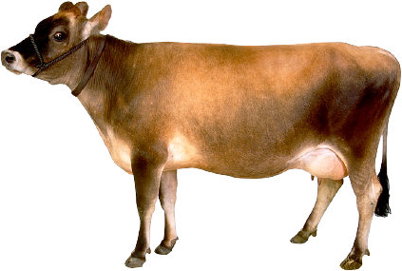

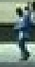
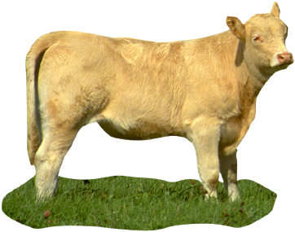

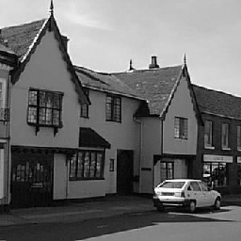
Standard approach to object detection
Classify local image patches at each location and scale.
Popular classifiers use SVMs or boosting.
Popular features are raw pixel intensity or wavelet outputs.
Local
features
Classifier
p( car | V_{L} )
no car
V_{L}

Slide 32

Problem 1:
Local features can be ambiguous

Slide 33
Solution: Context can disambiguate local features
Context = whole image, and/or other objects

Slide 34


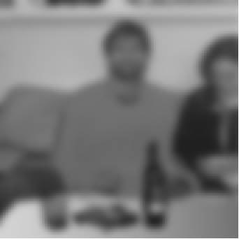
Effect of context on object detection
pedestrian
car
ash tray
Images by A. Torralba

Slide 35
Effect of context on object detection
pedestrian
car
ash tray
Identical local image features!
Images by A. Torralba

Slide 36
Problem 2: search space is HUGE
“Like finding needles in a haystack”
- Slow (many patches to examine)
- Error prone (classifier must have very low false positive rate)
s
Need to search over x,y locations
and scales s
y
x
10,000 patches/object/image
1,000,000 images/day
Plus, we want to do this for ~ 1000 objects

Slide 37
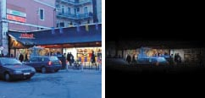
Solution 2: context can provide a prior on what to look for, and where to look for it
1.0
0.0
cars
desk
pedestrian
computer
Computers/desks unlikely outdoors
People most likely here
Torralba, IJCV 2003

Slide 38

Outline of talk: object detection
What is object detection?
Standard approach to object detection
Some problems with the standard approach
Our proposed solution: combine local,
bottom-up information with global, top-down information using a graphical model

Slide 39
Combining context and local detectors
C
O^{k}
O^{s}
…
…
…
P^{k}₁
P^{k}_{n}
P^{s}₁
P^{s}_{n}
V^{k}₁
V^{k}_{n}
V^{G}
V^{s}₁
V^{s}_{n}
Local patches for
keyboard detector
Local patches for
screen detector
“Gist” of the image
(PCA on filtered image)
Murphy, Torralba & Freeman, NIPS 2003

Slide 40
Combining context and local detectors
C
O^{k}
O^{s}
…
…
…
P^{k}₁
P^{k}_{n}
P^{s}₁
P^{s}_{n}
V^{k}₁
V^{k}_{n}
V^{G}
V^{s}₁
V^{s}_{n}
~ 10,000 nodes
~ 10,000 nodes
~10 object types
1. Big (~100,000 nodes)
2. Mixed directed/ undirected
3. Conditional (discriminative):

Slide 41
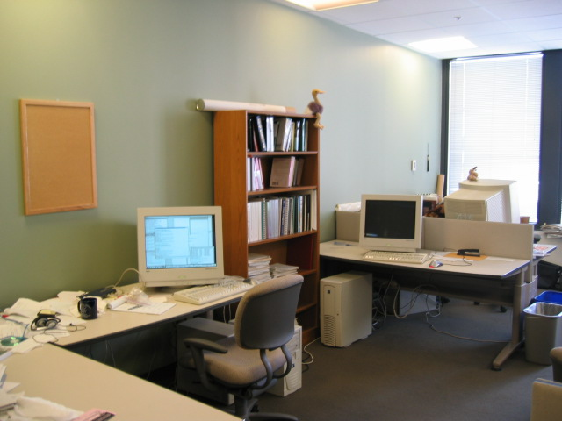
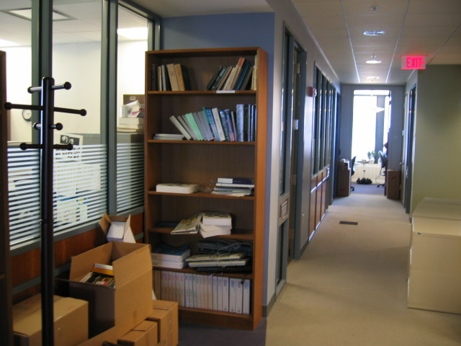
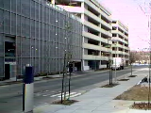
Scene categorization using the gist: discriminative version
office
corridor
street
…
C
Scene category
O^{k}
O^{s}
…
…
P^{k}₁
P^{k}_{n}
P^{s}₁
P^{s}_{n}
V^{k}₁
V^{k}_{n}
V^{G}
V^{s}₁
V^{s}_{n}
“Gist” of the image (output of PCA on whole image)
P(C|v^{G}) modeled using multi-class boosting

Slide 42
Scene categorization using the gist: generative version
office
corridor
street
…
C
Scene category
O^{k}
O^{s}
…
…
P^{k}₁
P^{k}_{n}
P^{s}₁
P^{s}_{n}
V^{k}₁
V^{k}_{n}
V^{G}
V^{s}₁
V^{s}_{n}
“Gist” of the image (output of PCA on whole image)
P(v^{G}|C) modeled using a mixture of Gaussians

Slide 43
Local patches for object detection and localization
C
O^{k}
O^{s}
…
…
P^{k}₁
P^{k}_{n}
P^{s}₁
P^{s}_{n}
P^{s}_{i} =1 iff there is a
screen in patch i
V^{k}₁
V^{k}_{n}
V^{G}
V^{s}₁
V^{s}_{n}
9000 nodes (outputs of
keyboard detector)
6000 nodes (outputs of
screen detector)

Slide 44
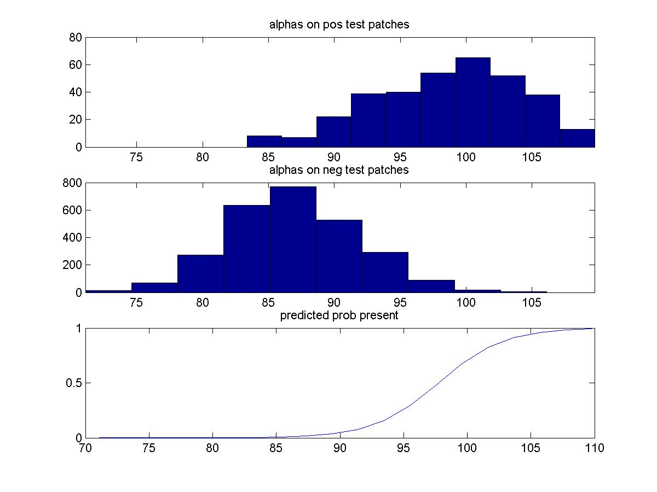
Converting output of boosted classifier to a probability distribution
Output of boosting
Sigmoid/logistic
weights
Offset/bias term

Slide 45

Location-invariant object detection
C
O^{k}
O^{s}
O^{s} =1 iff there is one or
more screens visible
anywhere in the image
…
…
P^{k}₁
P^{k}_{n}
P^{s}₁
P^{s}_{n}
V^{k}₁
V^{k}_{n}
V^{G}
V^{s}₁
V^{s}_{n}
Modeled as a (non-noisy) OR function
We do non-maximal suppression to pick a subset of patches, to
ameliorate non-independence and numerical problems

Slide 46
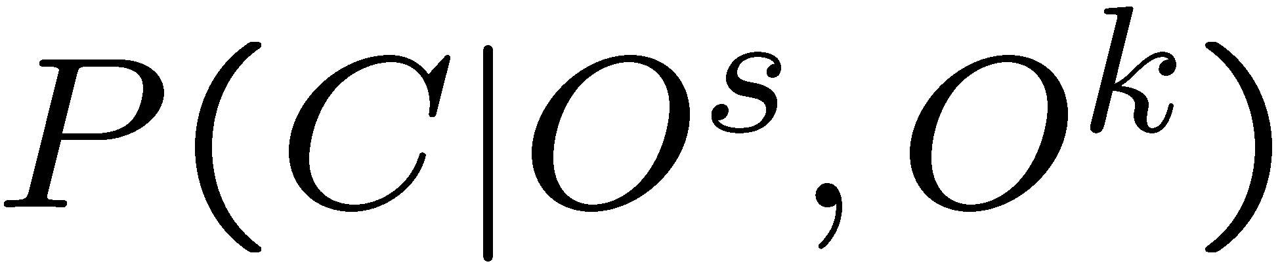
Probability of scene given objects
C
Logistic classifier
O^{k}
O^{s}
…
…
P^{k}₁
P^{k}_{n}
P^{s}₁
P^{s}_{n}
V^{k}₁
V^{k}_{n}
V^{G}
V^{s}₁
V^{s}_{n}
Modeled as softmax function
Problem:
Inference requires joint P(O^{s}, O^{k}|v^{s}, v^{k}) which may be intractable

Slide 47
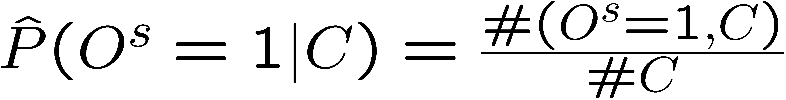
Probability of object given scene
C
Naïve-Bayes classifier
O^{k}
O^{s}
…
…
P^{k}₁
P^{k}_{n}
P^{s}₁
P^{s}_{n}
V^{k}₁
V^{k}_{n}
V^{G}
V^{s}₁
V^{s}_{n}
e.g., cars unlikely in an office, keyboards unlikely in a street

Slide 48
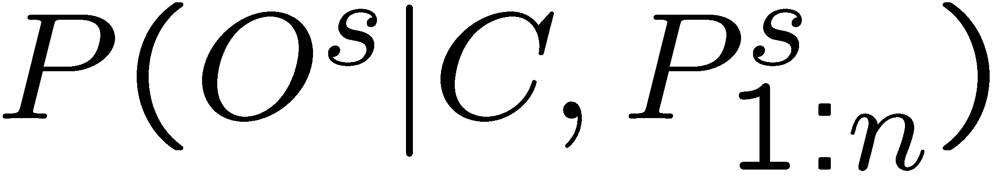
Problem with directed model
C
O^{k}
O^{s}
…
…
P^{k}₁
P^{k}_{n}
P^{s}₁
P^{s}_{n}
V^{k}₁
V^{k}_{n}
V^{G}
V^{s}₁
V^{s}_{n}
Problems:
1. How model
?
2. O^{s} d-separates P^{s}_{1:n} from C (bottom of V-structure)!
c.f. label-bias problem in max-ent Markov models

Slide 49

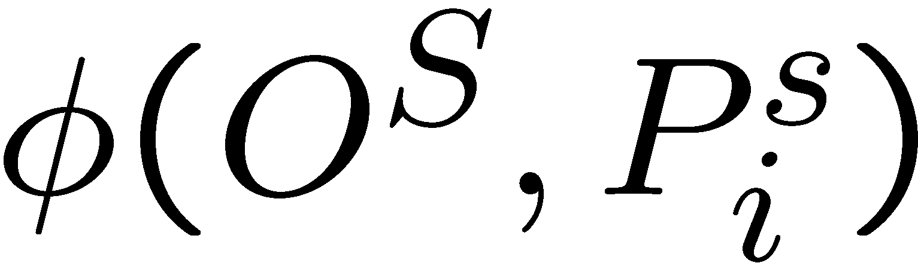
Undirected model
C
O^{k}
O^{s}
…
…
P^{k}₁
P^{k}_{n}
P^{s}₁
P^{s}_{n}
V^{k}₁
V^{k}_{n}
V^{G}
V^{s}₁
V^{s}_{n}
= i’th term of noisy-or

Slide 50
Outline of talk: object detection
What is object detection?
Standard approach to object detection
Some problems with the standard approach
Our proposed solution: combine local,
bottom-up information with global, top-down information using a graphical model
  Basic model: scenes and objects
  Inference
  Inference over time
  Scenes, objects and locations

Slide 51
Inference in the model
Bottom-up, from leaves to root
C
O^{k}
O^{s}
…
…
P^{k}₁
P^{k}_{n}
P^{s}₁
P^{s}_{n}
V^{k}₁
V^{k}_{n}
V^{G}
V^{s}₁
V^{s}_{n}

Slide 52
Inference in the model
Top-down, from root to leaves
C
O^{k}
O^{s}
…
…
P^{k}₁
P^{k}_{n}
P^{s}₁
P^{s}_{n}
V^{k}₁
V^{k}_{n}
V^{G}
V^{s}₁
V^{s}_{n}

Slide 53
Adaptive message passing
Bottom-up/ top-down message-passing schedule is
exact but costly
We would like to only run detectors if they are
  likely to result in a successful detection, or
  likely to inform us about the scene/ other objects
  (value of information criterion)
Simple sequential greedy algorithm:
  Estimate scene based on gist
  Look for the most probable object
  Update scene estimate
  Repeat

Slide 54
Outline of talk: object detection
What is object detection?
Standard approach to object detection
Some problems with the standard approach
Our proposed solution: combine local,
bottom-up information with global, top-down information using a graphical model
  Basic model: scenes and objects
  Inference
  Inference over time
  Scenes, objects and locations

Slide 55
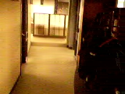

GM2: Scene recognition over time
…
C_{t-1}
C_{t}
HMM backbone
O^{k}
O^{s}
…
…
P^{k}₁
P^{k}_{n}
P^{s}₁
P^{s}_{n}
V^{k}₁
V^{k}_{n}
V^{G}
V^{s}₁
V^{s}_{n}
P(C_{t}|C_{t-1}) is a transition matrix, P(v^{G}|C) is a mixture of Gaussians
Cf. topological localization in robotics
Torralba, Murphy, Freeman, Rubin, ICCV 2003

Slide 56
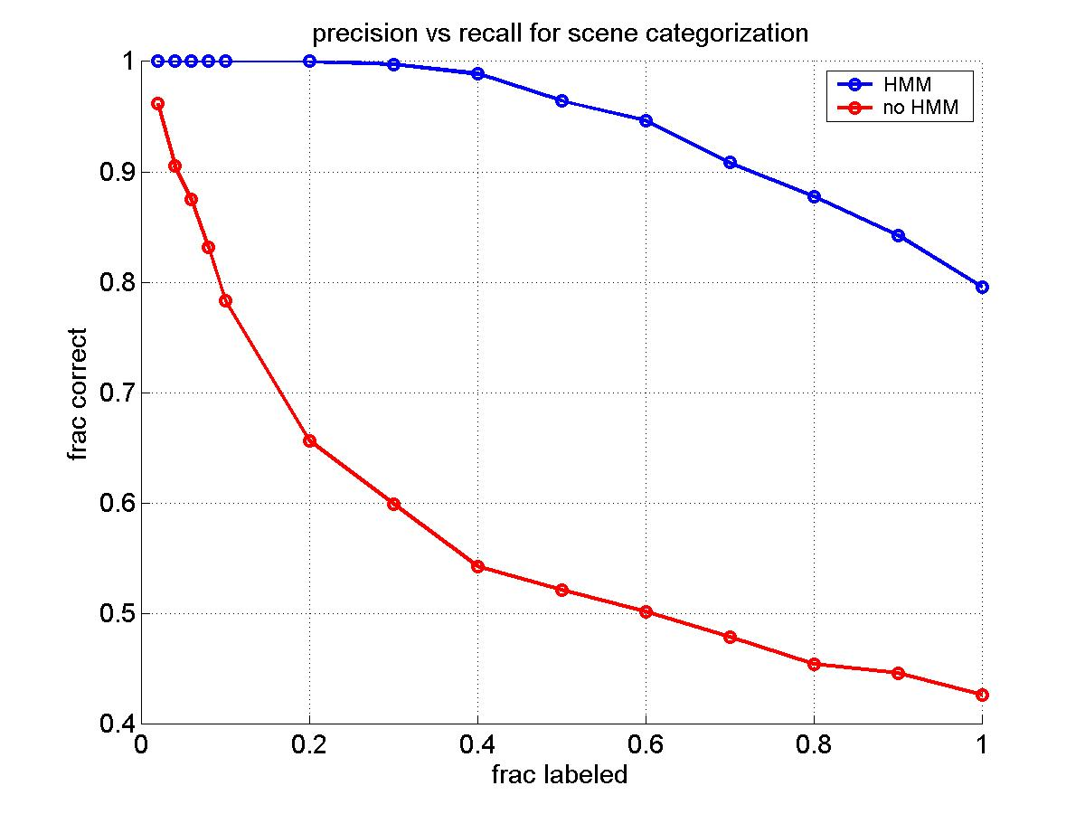
Benefit of using temporal integration

Slide 57
Outline of talk: object detection
What is object detection?
Standard approach to object detection
Some problems with the standard approach
Our proposed solution: combine local,
bottom-up information with global, top-down information using a graphical model
  Basic model: scenes and objects
  Inference
  Inference over time
  Scenes, objects and locations

Slide 58
Context can provide a prior on where to look
People most likely here

Slide 59
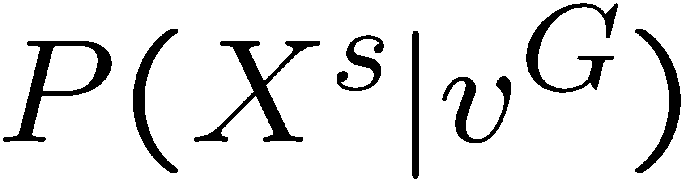
Predicting location/scale using gist
X^{s} = location/scale of
screens in the image
C
O^{k}
X^{k}
X^{s}
O^{s}
…
…
P^{k}₁
P^{k}_{n}
P^{s}₁
P^{s}_{n}
V^{k}₁
V^{k}_{n}
V^{G}
V^{s}₁
V^{s}_{n}
modeled using linear regression (for now)

Slide 60
Predicting location/scale using gist
X^{s} = location/scale of
screens in the image
C
O^{k}
X^{k}
X^{s}
O^{s}
…
…
P^{k}₁
P^{k}_{n}
P^{s}₁
P^{s}_{n}
V^{k}₁
V^{k}_{n}
V^{G}
V^{s}₁
V^{s}_{n}
Distance from patch i to expected location

Slide 61
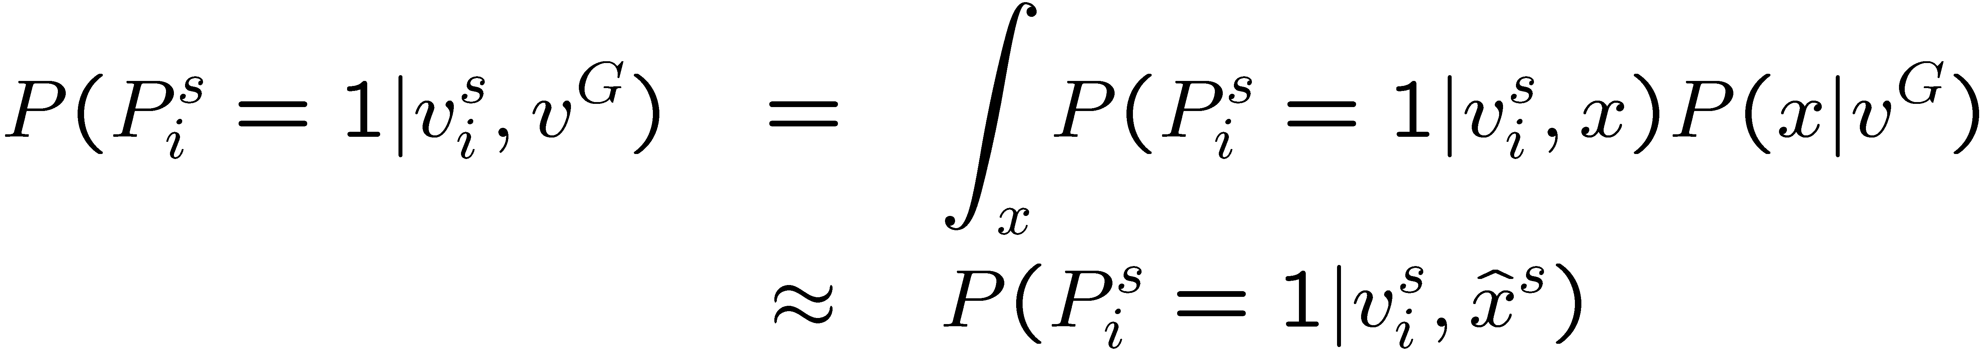
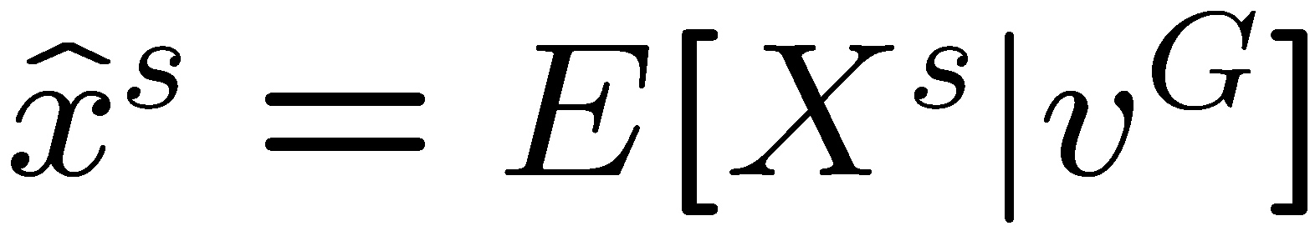
Approximate inference using location/ scale prior
C
O^{k}
X^{k}
X^{s}
O^{s}
P^{k}₁
…
P^{k}_{n}
P^{s}₁
…
P^{s}_{n}
sigmoid
Gaussian
V^{k}₁
V^{k}_{n}
V^{G}
V^{s}₁
V^{s}_{n}
Mean field approximation:
E f(X) ¼ f(E X)

Slide 62
GM 4: joint location modeling
C_{t-1}
C
O^{k}
X^{k}
X^{s}
O^{s}
…
…
P^{k}₁
P^{k}_{n}
P^{s}₁
P^{s}_{n}
V^{k}₁
V^{k}_{n}
V^{G}
V^{s}₁
V^{s}_{n}
Intuition: detected screens can predict where you expect
to find keyboards (and vice versa)
Graph is no longer a tree. Exact inference is hopeless.
So use 1 round of loopy belief propagation

Slide 63
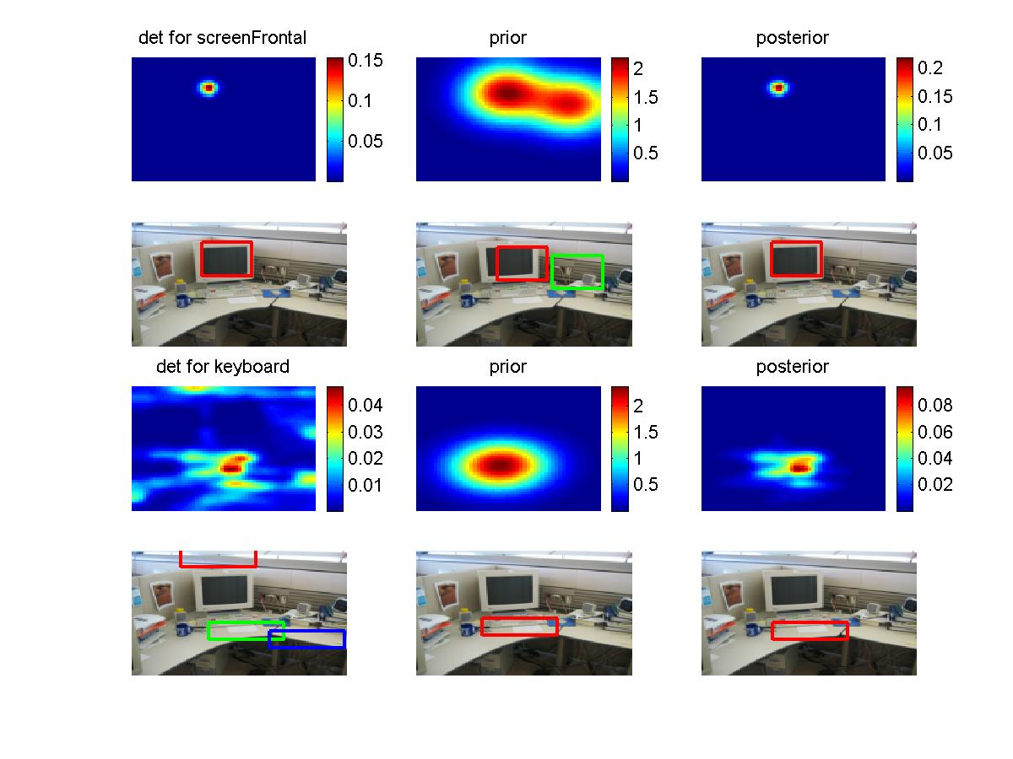
One round of BP for locn priming

Slide 64
Summary of object detection
Models are big and hairy
But the pain is worth it (better results)
We need a variety of different (fast, approximate) inference algorithms
We need parameter learning for directed and undirected, conditional and generative models

Slide 65
Outline of talk
BNT
Using graphical models (but not BNT!) for visual object recognition
Lessons learned: my new software philosophy

Slide 66
My new philosophy
Expose primitive functions
Bypass class hierarchy
Building blocks are no longer CPDs, but higher-level units of functionality
Example functions
  learn parameters (max. likelihood or MAP)
  evaluate likelihood of data
  predict future data
Example probability models
  Mixtures of Gaussians
  Multinomials
  HMMs
  MRFs with pairwise potentials

Slide 67
HMM toolbox
X₁
X₂
X₃
Y₁
Y₃
Y₂
Inference
  Online filtering: forwards algo. (discrete state Kalman)
  Offline smoothing: backwards algo.
  Observed nodes are removed before inference, i.e., P(Q_{t}|y_{t}) computed by separate routine
Learning:
  Transition matrix estimated by counting
  Observation model can be arbitrary (e.g., mixture of Gaussians)
  May be estimate from fully or partially observed data

Slide 68
Example: scene categorization
Learning:
counts = compute_counts([place_num…]);
hmm.transmat = mk_stochastic(counts);
hmm.prior = normalize(ones(Ncat,1));
[hmm.mu, hmm.Sigma] = mixgauss_em(trainFeatures, Ncat);
Inference:
ev = mixgauss_prob(testFeatures, hmm.mu, hmm.Sigma);
belPlace = fwdback(hmm.prior, hmm.transmat, ev, 'fwd_only', 1);

Slide 69
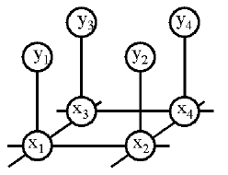
BP/MRF2 toolbox
Observed pixels
Latent labels
Estimate P(x₁, …, x_{n} | y₁, …, y_{n})
Ψ(x_{i}, y_{i}) = P(observe y_{i} | x_{i}): local evidence
Ψ(x_{i}, x_{j}) / exp(-J(x_{i}, x_{j})): compatibility matrix
c.f., Ising/Potts model

Slide 70
BP/MRF2 toolbox
Inference
  Loopy belief propagation for pairwise potentials
  Either 2D lattice or arbitrary graph
  Observed leaf nodes are removed before inference
Learning:
  Observation model can be arbitrary (generative or
  discriminative)
  Horizontal compatibilities can be estimated by
    counting (pseudo-likelihood approximation)
    IPF (iterative proportional fitting)
    Conjugate gradient (with exact or approx. inference)
  Currently assumes fully observed data

Slide 71
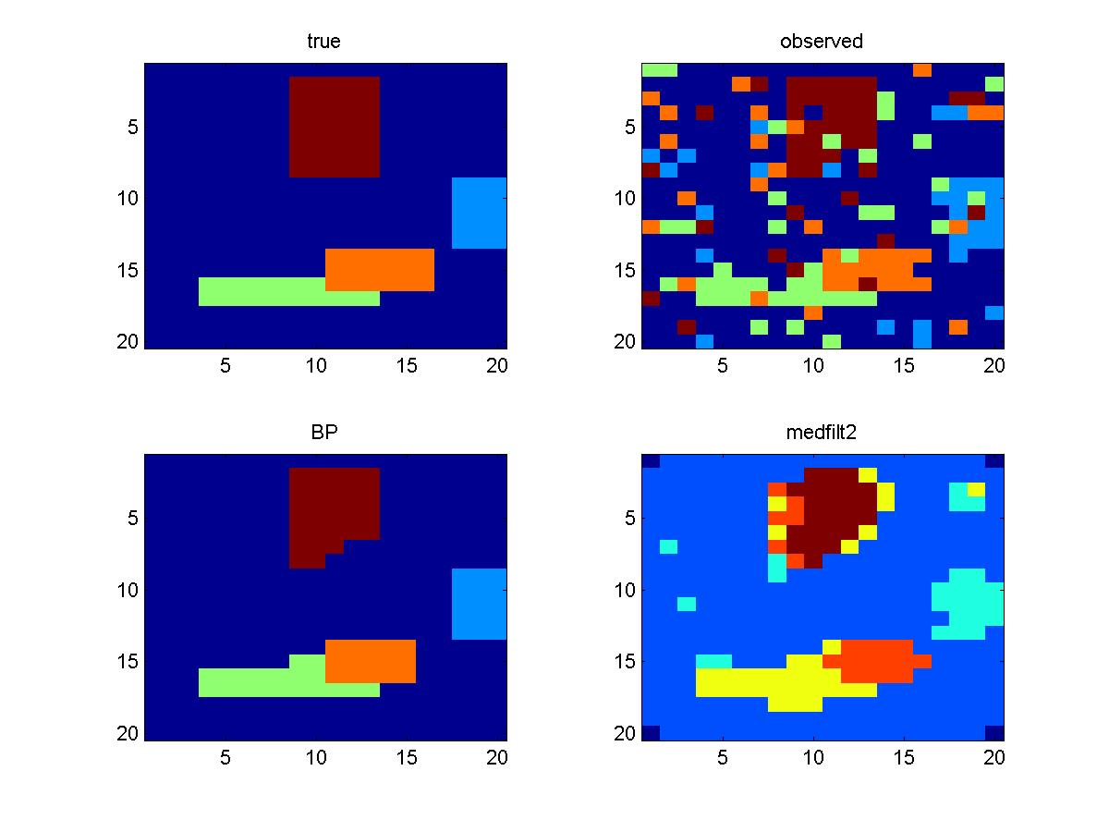
Example: BP for 2D lattice
obsModel = [0.8 0.05 0.05 0.05 0.05;
0.05 0.8 0.05 0.05 0.05;
… ];
kernel = [ … ];
npatches = 4; % green, orange, brown, blue
nrows = 20; ncols = 20;
I = mk_mondrian(nrows, ncols, npatches) + 1;
noisyI = multinomial_sample(I, obsModel);
localEv = multinomial_prob(noisyImg, obsModel);
[MAP, niter] = bp_mpe_mrf2_lattice2(kernel, localEv2);
imagesc(MAP)

Slide 72
Summary
BNT is a popular package for graphical models
But it is mostly useful only for pedagogical purposes.
Other existing software is also inadequate.
Real applications of GMs need a large collection of tools which are
  Easy to combine and modify
  Allow user to make speed/accuracy tradeoffs by using different algorithms (possibly in combination)

Slide 73
Local patches for object detection and localization
C
O^{k}
O^{s}
…
…
P^{k}₁
P^{k}_{n}
P^{s}₁
P^{s}_{n}
P^{s}_{i} =1 iff there is a
screen in patch i
V^{k}₁
V^{k}_{n}
V^{G}
V^{s}₁
V^{s}_{n}
Boosted classifier
applied to patch v_{i}^{s}
9000 nodes (outputs of
keyboard detector)
6000 nodes (outputs of
screen detector)
Logistic/sigmoid function

Slide 74
Problem with undirected model
C
O^{k}
O^{s}
…
…
P^{k}₁
P^{k}_{n}
P^{s}₁
P^{s}_{n}
V^{k}₁
V^{k}_{n}
V^{G}
V^{s}₁
V^{s}_{n}
Problem:

